Slide 1
Sustainable Competitive Advantage
An Introduction to LunchBadger
Al Tsang, Founder and CEO al@lunchbadger.com
Notes:
Vivienne –maybe can do a better subtitle?

Slide 2
Management Team
Brains, Muscle, Efficiency
Al Tsang
Founder and CEO
Widely recognized practitioner and thought leader in microservices and APIs
Open source champion, creator of LoopBack.js
Co-founder and CTO of StrongLoop, acquired by IBM Sep 2015
Kevin Swiber
Head of Engineering
Enterprise architecture and APIs
Early member of Apigee, IPO and then acquired by Google Sept 2016
Serhii Kuts
Senior Backend Engineer
Microservices, DevOps
Ciklum
Vincenzo Chianese
Senior Full Stack Engineer
Node.js, SPA
Apiary
Kristof Olbinski
Senior Frontend Engineer
React, Redux, SPA
DNV GL
Stacy Hunt
User Experience
Minimalism Pioneer
Fact0ry
Dellaena Malisewski
Director of Developer Marketing
Guerilla growth hacker and developer community leader
Marketing operations at O’Reilly, Venture Beat, 500 Startups
Vivienne Scholl
Visual Design
Visual and Design Harmony
Avenue 4 Design
Notes:
Vivienne – ideally if we can keep slides 4+5 onto one page but preserve the content

Slide 3
LunchBadger makes a microservice and serverless platform
for developing and managing APIs
that works across any cloud.

Slide 4
The Problem

Slide 5

Are you even in the game?
APIs = business leverage and amplification
APIs = The Ante and Tablestakes

Slide 6


HOW are you building your apps and APIs?
vs.
A monolithic app
All or nothing — a big, giant thing that can’t fit through the shipping door.
A microservice app
Continuous updating in parts.
Business requirements change rapidly AND continuously — so the need for shipping updated version of your app are increasing exponentially.

Slide 7
Development is changing because developing on Cloud is DIFFERENT
Meanwhile the PACE of Development has only accelerated with the need for APIs
Easy to get on initially
But harder to stay on, and even harder to manage
GOOD!
BAD!

Slide 8
Choice: Multi-Cloud is the way of the future

Slide 9

APIs backed by microservices demand constant change because of the proliferation of all networked devices
Development and operations must go hand in hand – Containers are tricky
Microservices is like herding cats… through a maze of deployment and mismatched runtimes
A more agile application development is needed – serverless
Lots of pitfalls
Microservices is a style, not something Concrete
Notes:
Vivienne – the folks liked this slide – but a lot to read through even with the build – a clever way to break it up? Maybe into more slides?

Slide 10




APIs and Microservices Are HARD
Billions have been spent NOT solving the problem…
Typically, previous attempts (like SOA):
Solved very little of the problem
Were based on proprietary standards and technology
Were not engineered specifically for the cloud
Required technical expertise that was highly specialized and hard to come by
Were very slow and brittle to iterate on changes
Became very bloated solutions trying to generally solve too many use cases
1997
2005
2006
2014

Slide 11
Trailblazers that did solve this problem:

Slide 12

… but it’s “secret sauce” and highly bespoke to their orgs

Slide 13

Everyone else is here
…inexperienced and poorly equipped in a world that is rapidly moving to cloud-based APIs built with serverless and microservices

Slide 14
LunchBadger solves this problem.

Slide 15


Our Offerings Today
Express Gateway: An API Gateway built on ExpressJS
API gateway - the heart of microservices
Large early adoption
Proudly sponsored by LunchBadger, Joyent and the Node Foundation

Slide 16




Express Gateway is becoming ubiquitous
Wide Industries & Sectors
Fortune 500
Global Adoption

Slide 17
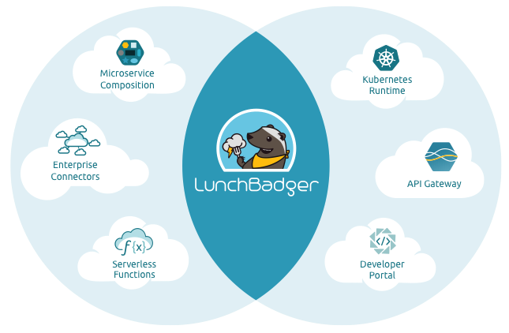
Our Offerings Today
LunchBadger: Microservices and Serverless Platform
Flagship product
Commercial – “the rest of the toolbox”
Co-developed and piloted by large enterprises

Slide 18
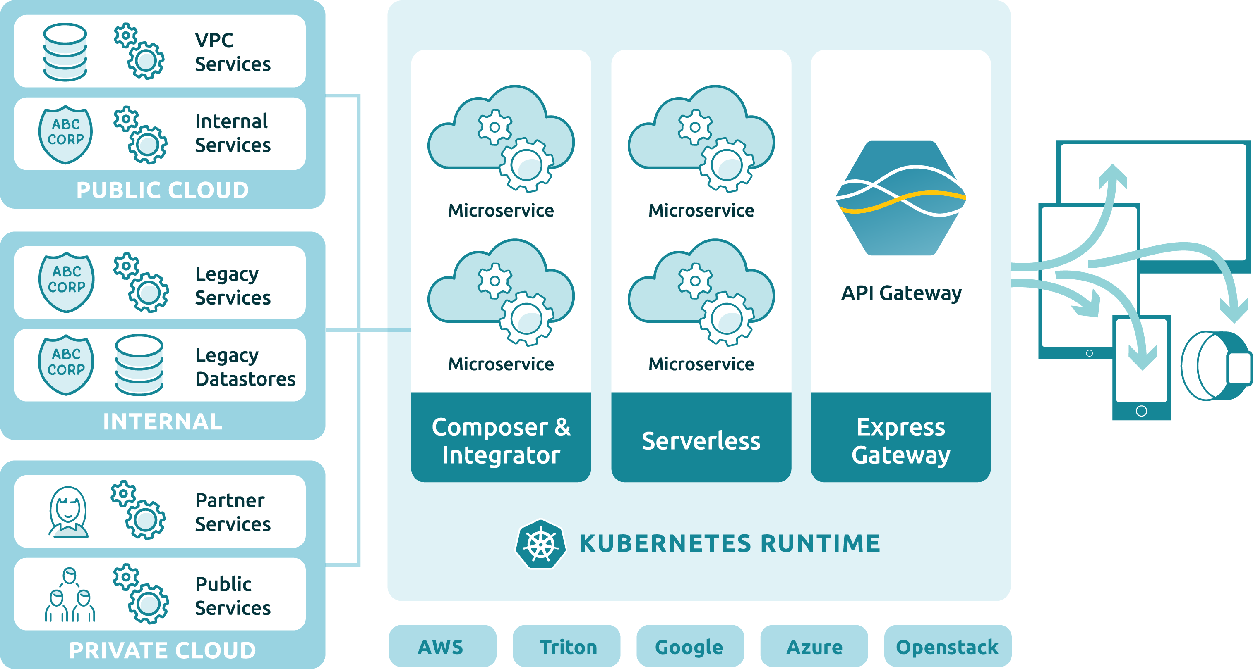
LunchBadger

Slide 19
Walkthrough

Slide 20
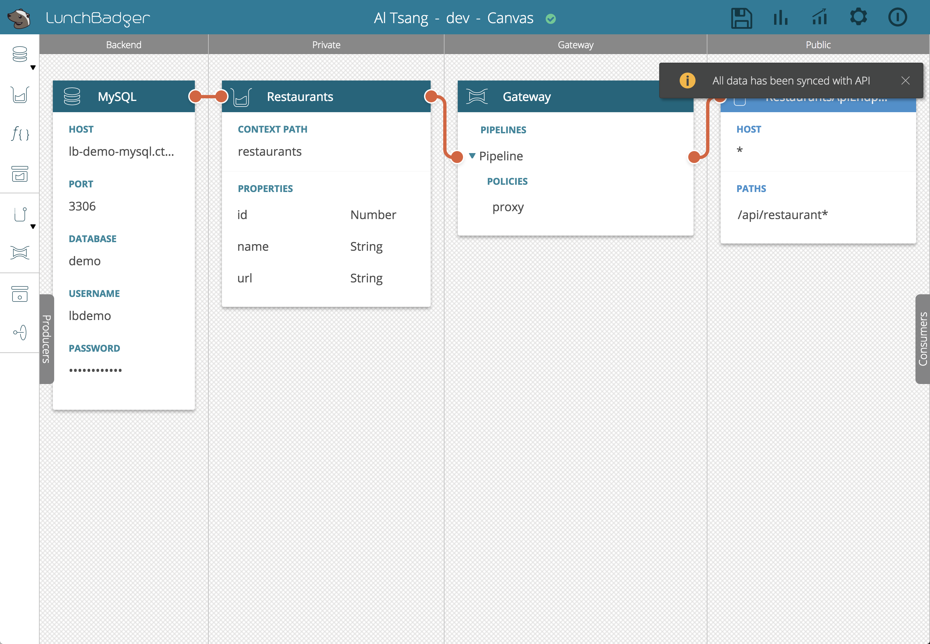

Slide 21
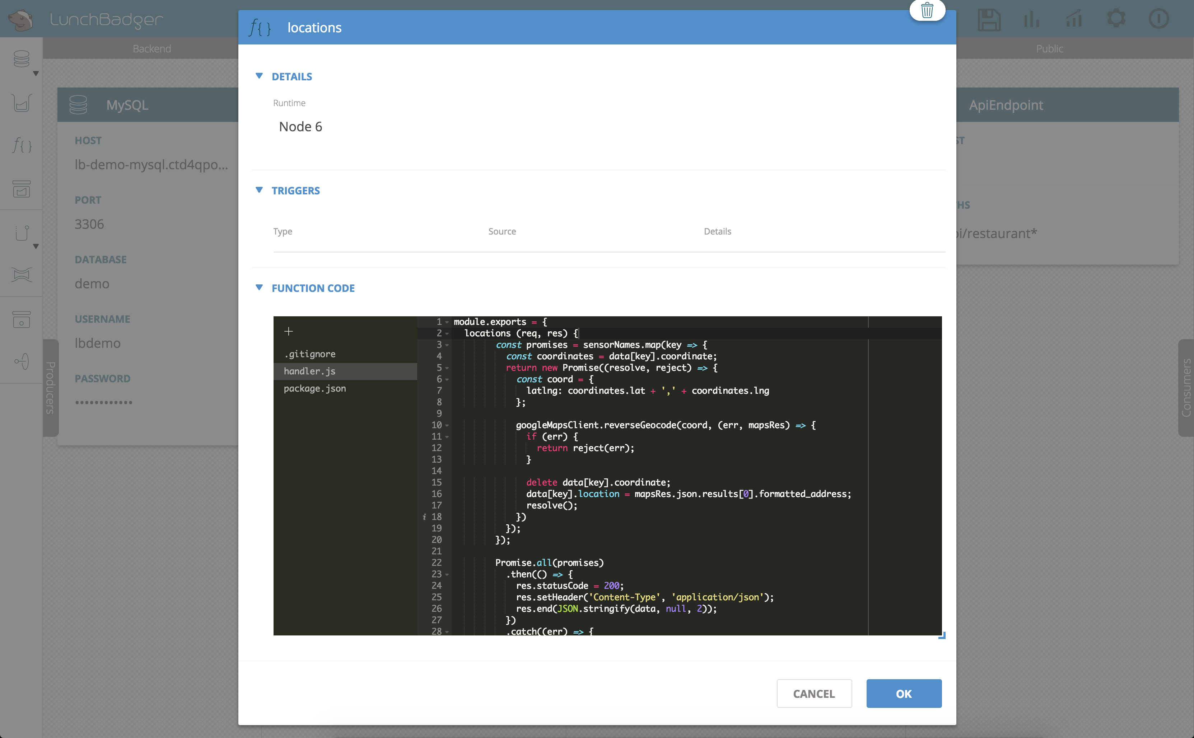

Slide 22
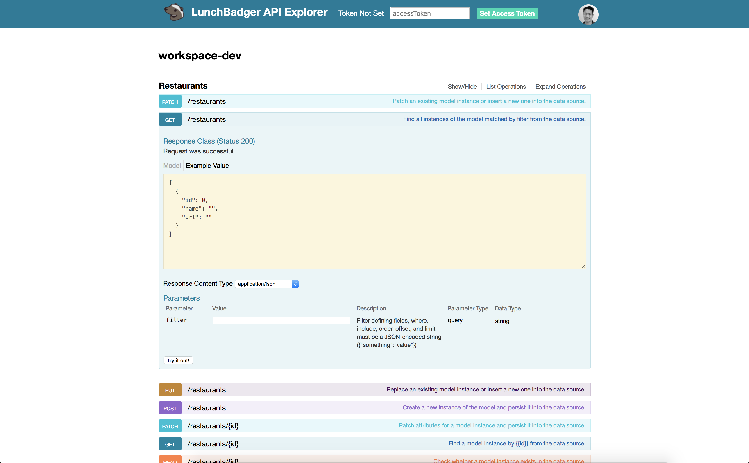

Slide 23

Unique Value
LunchBadger drastically reduces your time to market, repeatedly and sustainably
Concentrate on core IP
Automate boilerplate and scaffolding
Reduce overall complexity operating in the cloud
Agile development actually attained and benefits realized
Notes:
Vivienne – new slide – needs to be broken up and can use some graphical support

Slide 24

Unique Value
LunchBadger empowers non-elite engineers with hardcore productivity and technical enablement
Learn and adopt microservices best practices built into the tooling
TBD – Attain quicker, cheaper, higher quality software throughout the ranks
Align all resources through one visual playbook
Notes:
Vivienne – new slide – needs to be broken up and can use some graphical support

Slide 25

Unique Value
LunchBadger turns your everyday business’ functions into strategic digital assets – APIs
New customer acquisition channels
New revenue opportunities
New partner integration possibilities
Notes:
Vivienne – new slide – needs to be broken up and can use some graphical support

Slide 26




Contact Us – this should be customized
Express Gateway
www.express-gateway.io
github.com/ ExpressGateway/express-gateway
@express_gateway
facebook.com/ExpressJSGateway
LunchBadger
www.lunchbadger.com
@lunchbadger
facebook.com/LunchBadger
Notes:
Ughhhh – I need a better way of organizing this info for both Express Gateway and LunchBadger – help!

Slide 27
Q/A
Thank you for your time!

Slide 28
Appendix

Slide 29
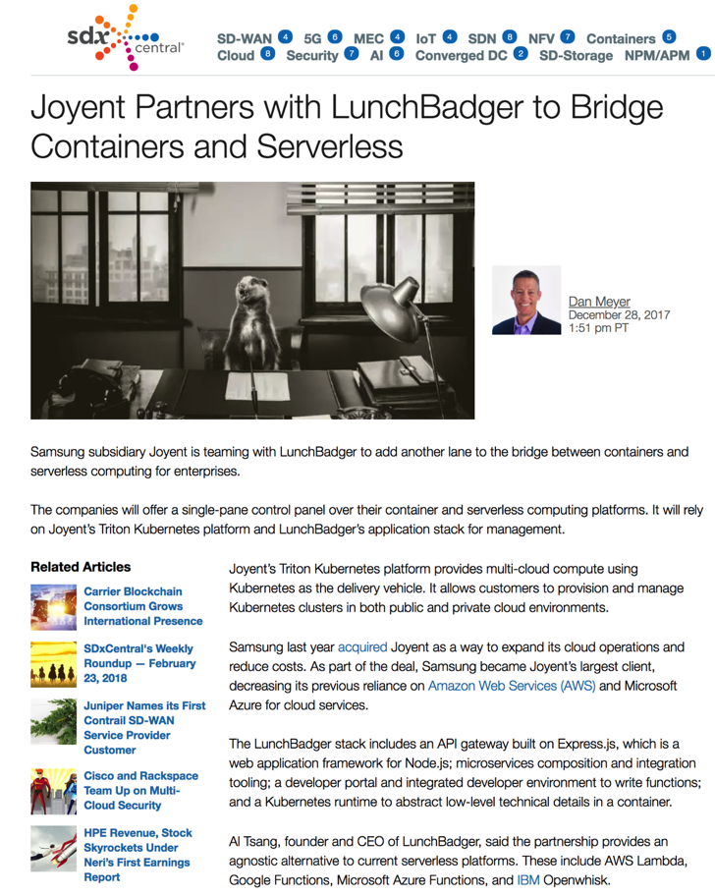
SDX Central
“The value is that the infrastructure play is table stakes with Kubernetes,” Tsang explained of the combined offering. “We have had two-plus years working with Kubernetes and can now offer enterprises a single-pane of glass to manage all of their microservices, whether they are in containers or using serverless.”

Slide 30
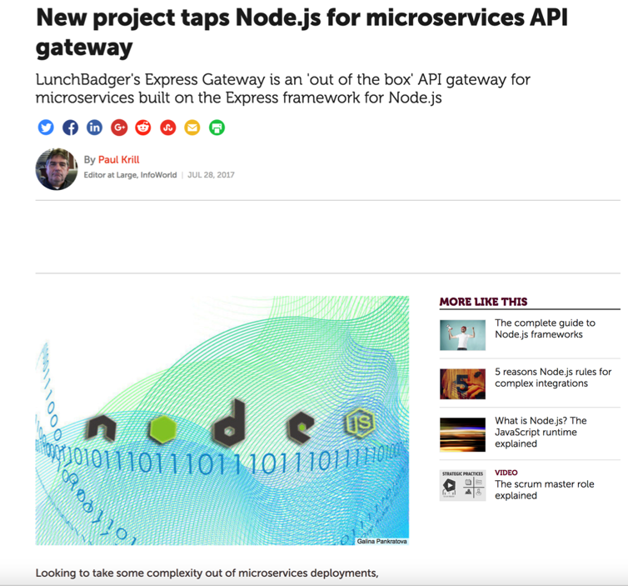
InfoWorld
“Express Gateway offers centralized configuration, API consumer and credentials management, and a plug-in framework. An API gateway is the heart of microservices, LunchBadger CEO Al Tsang said. “It’s a key piece of infrastructure that you must have,” enabling microservices to work with infrastructure such as Kubernetes container orchestration, Tsang said. LunchBadger offers an API and microservices platform.”

Slide 31

Hello CNCF!!!

Slide 32
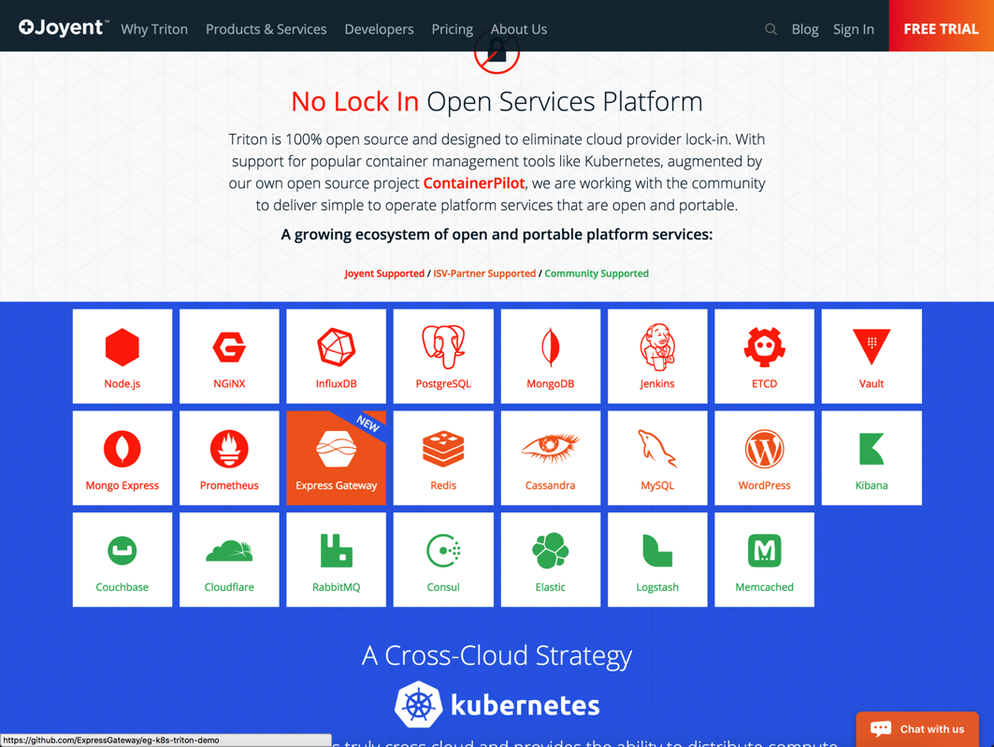
Express Gateway on Joyent

Slide 33
Partner Spotlight
LunchBadger = Joyent’s AWS Lambda + API Gateway Killer
Reseller Partner
Existing Enterprise Accounts
Multi-Cloud Focus
Open Source Competitive Advantage
Notes:
Vivienne – the bullet points might change

Slide 34








Competitive Landscape
Cloud Enabled APIs
Complexity
Time to Value
Commoditized Legacy

